Slide 1
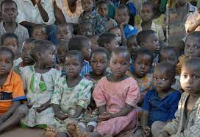
ORPHANAGE MANAGEMENT SYSTEM
By
C VAISHNAVI(2110030096)
P PRANEETHA(2110030099)
S SAI NIKHITHA (2110030098)
G VAMSHI(2110030370)

Slide 2
INTRODUCTION
As orphanages has been little in old style practice it lead to managing orphanage system in manual way which is storing information in notebook or registers.
People need to store not one two columns of information they need different sets for storing different sectors of information.
As there are many systems to manage the orphanage like students entry , adoption , supplies information, and many more .
All this managing is not been easy as they may lead to lot of confusion.

Slide 3
PROJECT REQUIREMENTS
Hardware Requirement
The following are the hardware devices that will be needed for the system
i. A personal computer ( Pentium 4, 500Mhz or higher recommendation)
ii. Minimum RAM of 500Mb
iii. Un-interrupted Power Supply (UPS)
iv. Printer

Slide 4
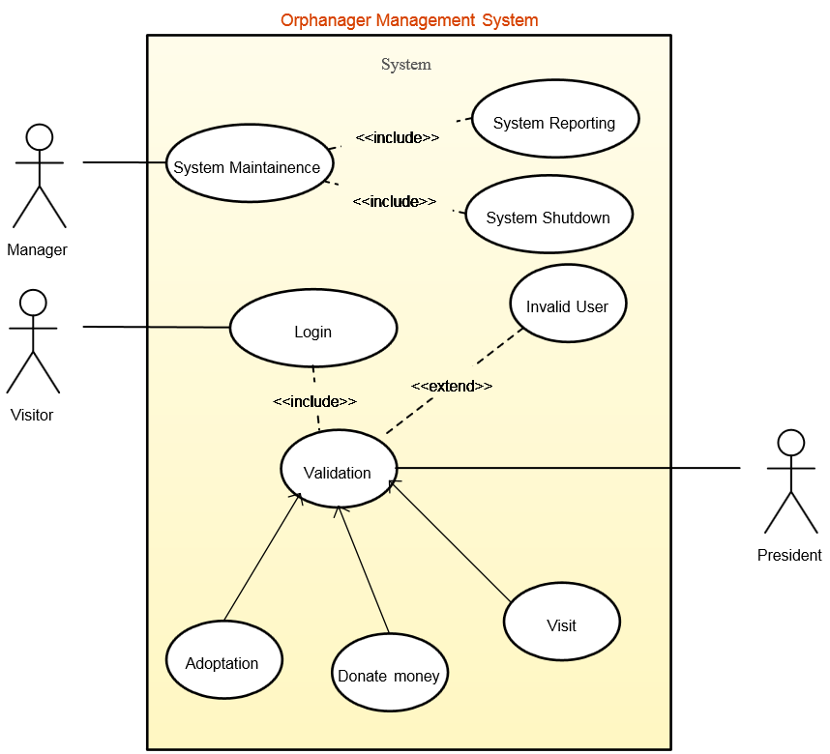
USE CASE DIAGRAM

Slide 5
LITERATURE REVIEW
Creating an application for managing the number of orphans, their names, personal habits, activities, their original parents, health conditions, etc. details.
With this maintaining the records of the orphanage will be made easy to handle and access by the officials.
It will enhance timeliness, accuracy, reliability and above all easy access to data and information.
The system will help to reduce the high rate of labour using to its high level of automation and independency

Slide 6
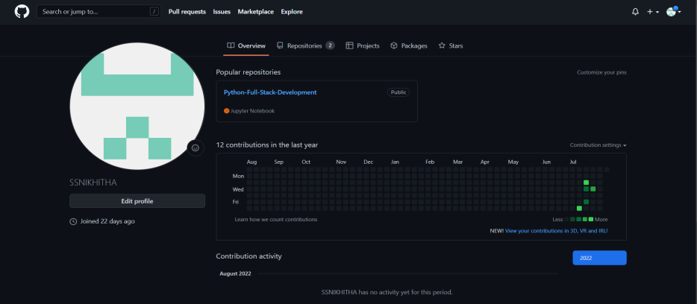
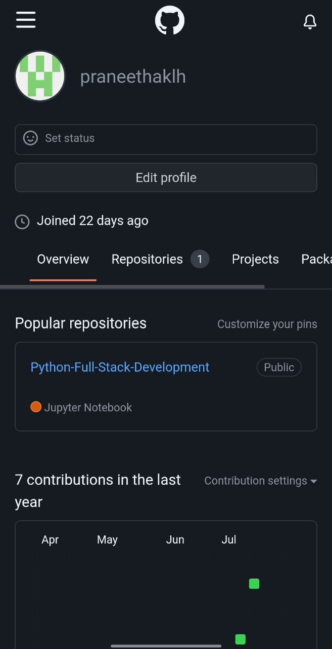
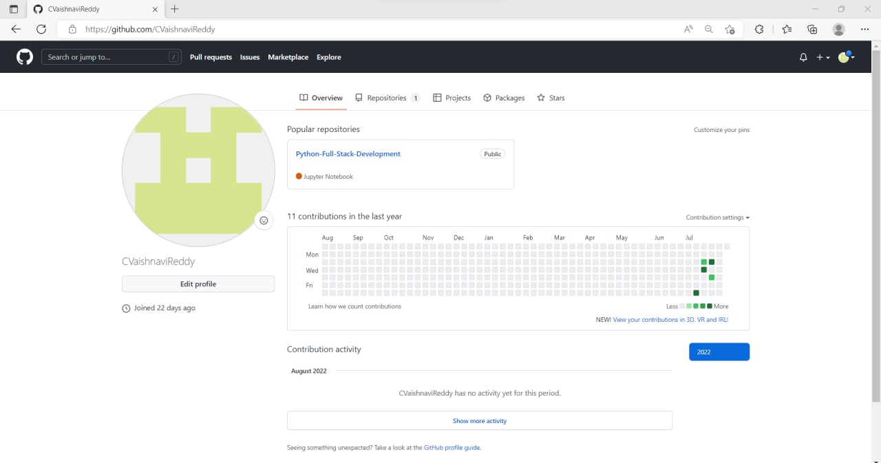
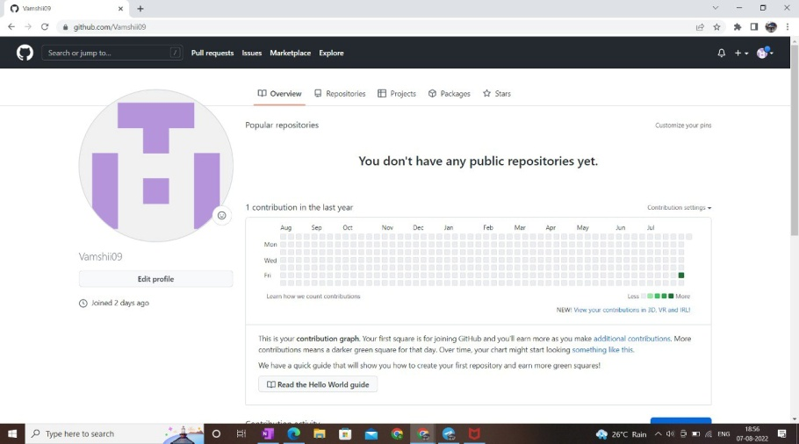
GitHub setup

Slide 7
Data Set Collection
Dataset is a collection of related sets of information that
is required in Application building.
Name
Age
DOB
Donor

Slide 8
TOOLS REQUIRED
Software Requirement
i. Minimum of Windows XP/Vista
Operating System
ii. MySQL
iii. Star UML
Iv. TerraER

Slide 9
Division of work among the group members
S SAI NIKHITHA – data collection
P PRANEETHA – data modelling design
C VAISHNAVI- problem domain
G VAMSHI- research on previous solutions

Slide 10

THANK YOU

